Slide 1


Maximising use of community assets in a cost-of-living crisis
Views from Locality, Old Fire Station, Wrigleys Solicitors, Soar …. And you!
Funded by

Slide 2
Agenda
1. Mick McGrath, Locality – introductions (5mins)
2. What people want from session record (5 mins)
3. Fran Etherington - Old Fire Station experiences, Gipton (15 mins)
4. Laura Moss – Wrigleys Solicitors - legal aspects of using assets in more flexible ways (15 mins)
5. Megan Ohri – SOAR/SOAR Works experiences (15 mins)
6. Q and A – discussion on experiences and ideas (25 mins)
7. Has the session met your needs – informal chats at Convention (5 mins)

Slide 3
Why Community Ownership?
Base for local services, activities, people
Pride of place – and cost of doing nothing
Community empowerment – building skills & confidence
Financial sustainability – greater income generation and control
Generating local wealth - multiplier effect locally

Slide 4



Cost of Living Crisis - How is this affecting member business?
Increased demand for services - debt advice - food - warm hubs - mental health support
Staffing
issues
- recruitment - loss of staff - staff wellbeing
Difficulties
planning &
forecasting - using reserves
Changes to
provision - reduce services - reduce hours - close down?

Slide 5
How are rising costs affecting your community?
fuel poverty
worsening health (mental and physical)
lack of affordable housing
foodbank use at an all time high
long term affect of stress / austerity
worried about vulnerable, elderly, young people, disabled people, people losing jobs – just tip of the iceberg!
“People are frightened and lashing out.”

Slide 6
“What do you hope to get out of this session?”

Slide 7
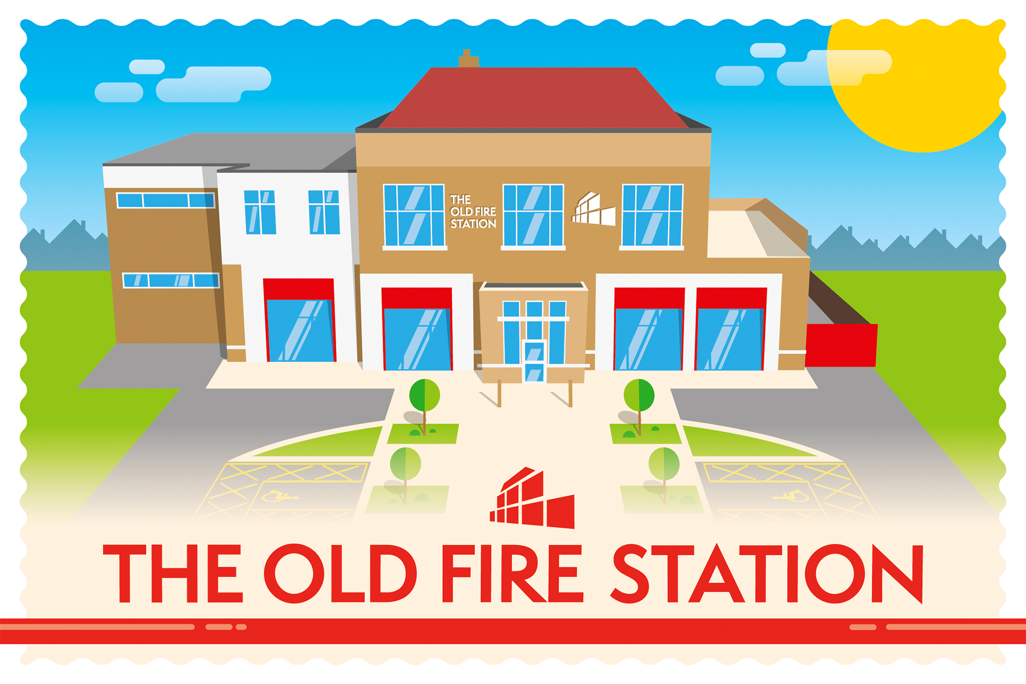

Slide 8


The Old Fire Station, Gipton, East Leeds.
A thriving, welcoming and sustainable community hub where all are made to feel valued and safe, whilst providing the opportunity to learn, develop and engage in positive activities.
There are six charities in the building, 6 meeting rooms, a café and a cookery school on site.

Slide 9
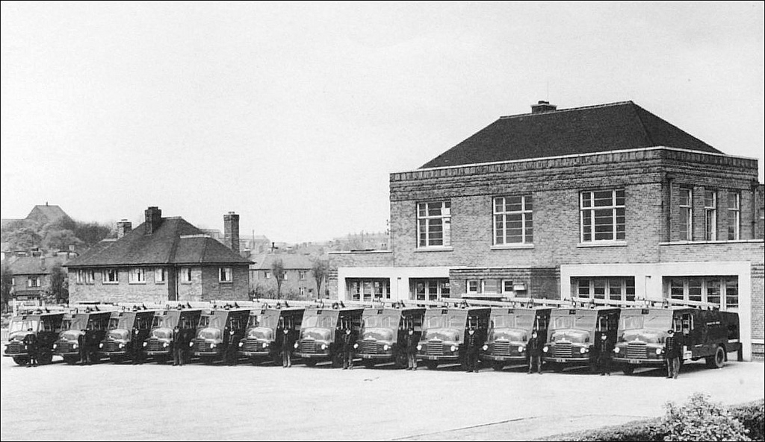
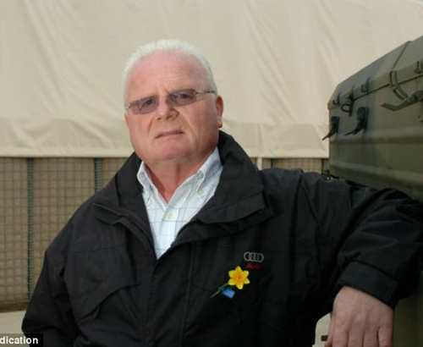

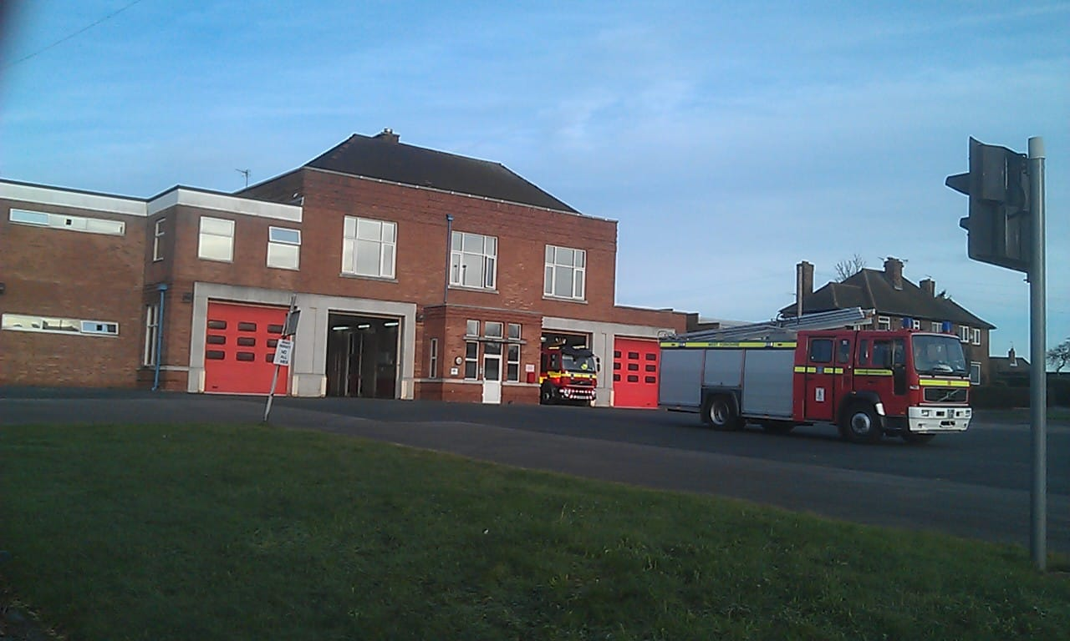
Gipton Fire Station – The Eastern
1937 – 2015
How we came about:
2015 WYFRS moved up the road to Killingbeck
Local charities approach LCF
Jimi Heselden’s family looking for a legacy project
Funded by a grant from Jimbo’s Fund, through Leeds Community Foundation, GFS Community Enterprise purchased and renovated the building.
Opened in September 2017

Slide 10

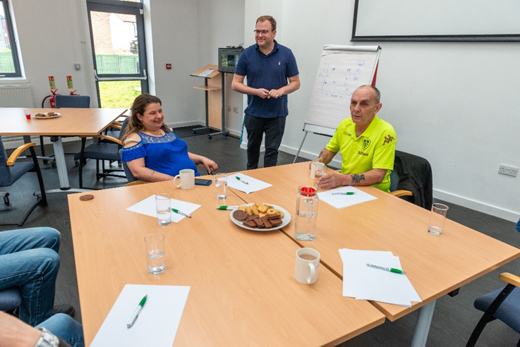
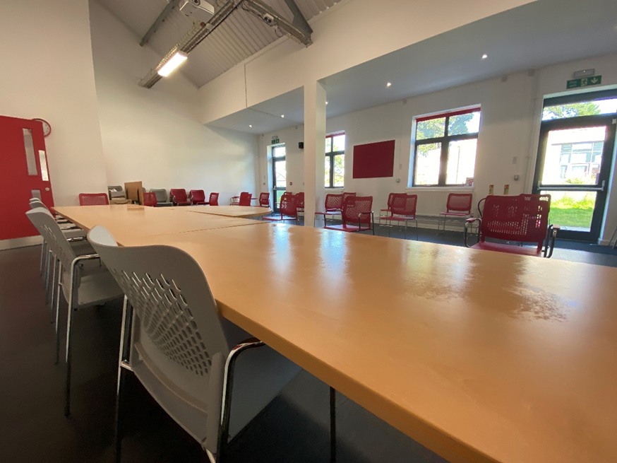

Maximizing the use of community assets in a Cost of Living Crisis
1: How is The Old Fire Station itself surviving?
Financial sustainability through a breadth of Room Hire including kids parties, Slimming World NHS training days, Covid Jabs, - charging a range of prices depending on the booker eg Community, Charity, Commercial and NHS/Council rates.
Room Hire Prices have been increased a little each year to stay in line with costs.
Including Room Hire and staffing in grant applications to cover our costs – e’.g Healthy Holiday activities.
Renting office space to other third sector organisations.
Fixed rate utilities until Nov 2023
Strong Financial planning throughout the pandemic and Cost of Living crisis – monthly meetings to discuss position and re forecast if needed so we always know where we are financially. We feel the professional costs of this is well worth while to the project.

Slide 11








The Old Fire Station Tenants

Slide 12

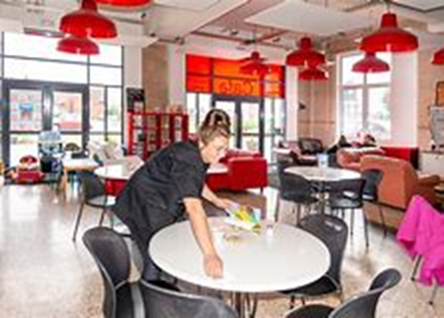

2: How does The Old Fire Station support the community?
Working in partnership with other organisations both in the building and the wider community to create a strong support network e.g applying for group funding to deliver Warm packs of hot water bottles, draught excluders etc to people, creating a calendar of events, warm spaces and activities in the area
Opening weekly on a Monday Night as a warm space – Funded by Stay Well This Winter. PAYF hot food, Board Games and the TV will be on. In our café space with free WiFi. People can be referred from other groups to come along.
Pop up shop once per week run by volunteers with food and clothes 3 items for £1. Food supplied by Fare Share and Amazon.
Café open to the public 5 days per week leads to conversations and support – it’s the heart of the building. People call in as they know they will get help – very high levels of anxiety at the moment. One of our volunteers created a pack of information for staff to use to give advice and support – phone numbers, stay warm advice etc.
Branding as many activities and events as we can as Warm Spaces – to highlight the fact we are open to all and that for example gardening will keep you warm, help make new friends and increase well being

Slide 13
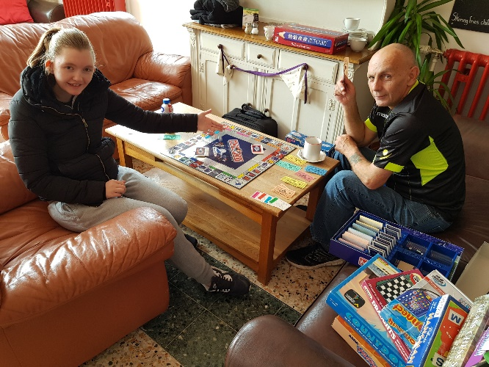
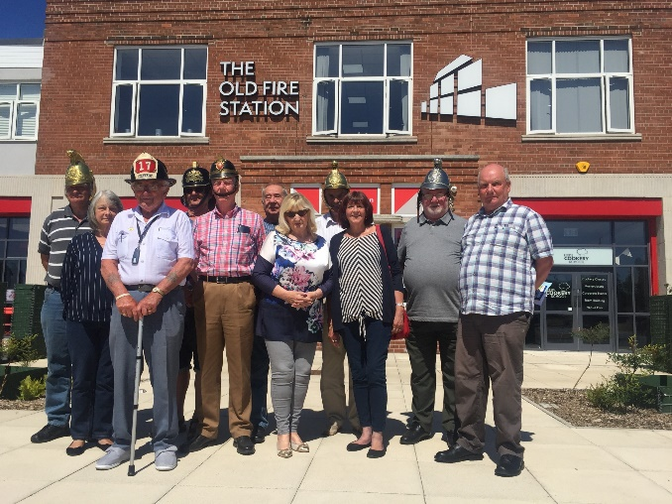
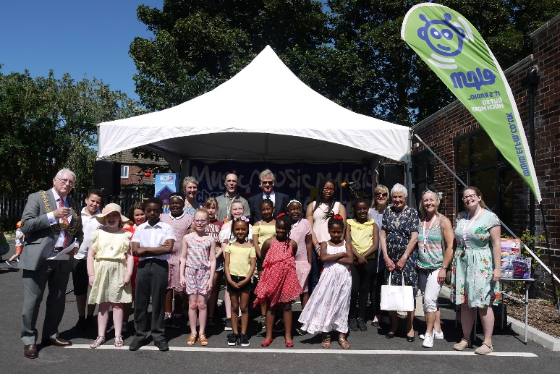


3: How is The Old Fire Station supporting our staff and volunteers
One off cost of living crisis payment to all of The Old Fire Station staff
1-2-1’s every 6 weeks to talk about how they are and what support they need
Wellbeing activities such as crafts and pizza making – holding a Staff wellbeing day in the Spring.

Slide 14
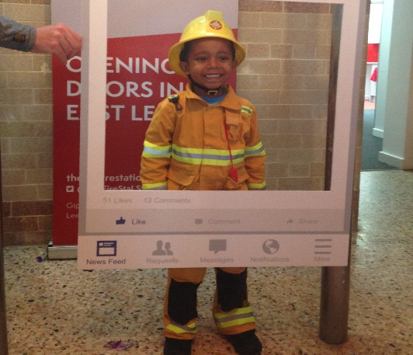
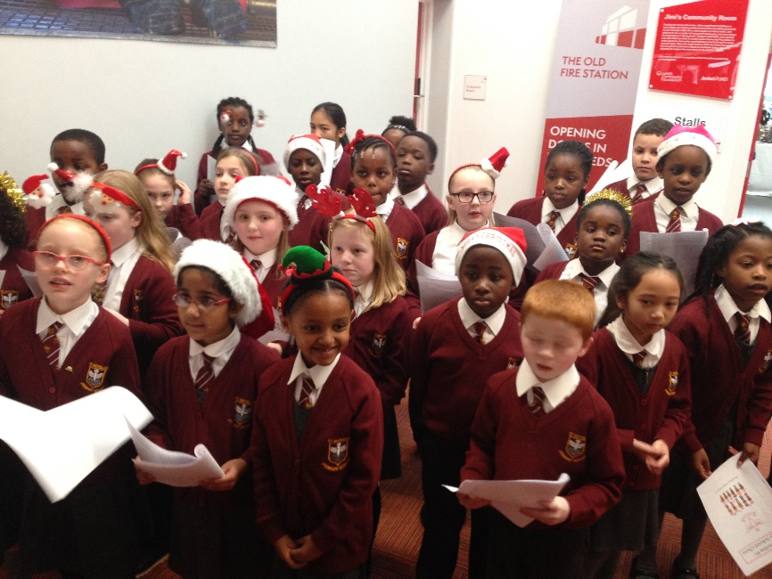
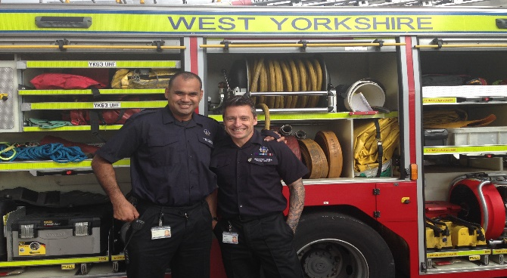
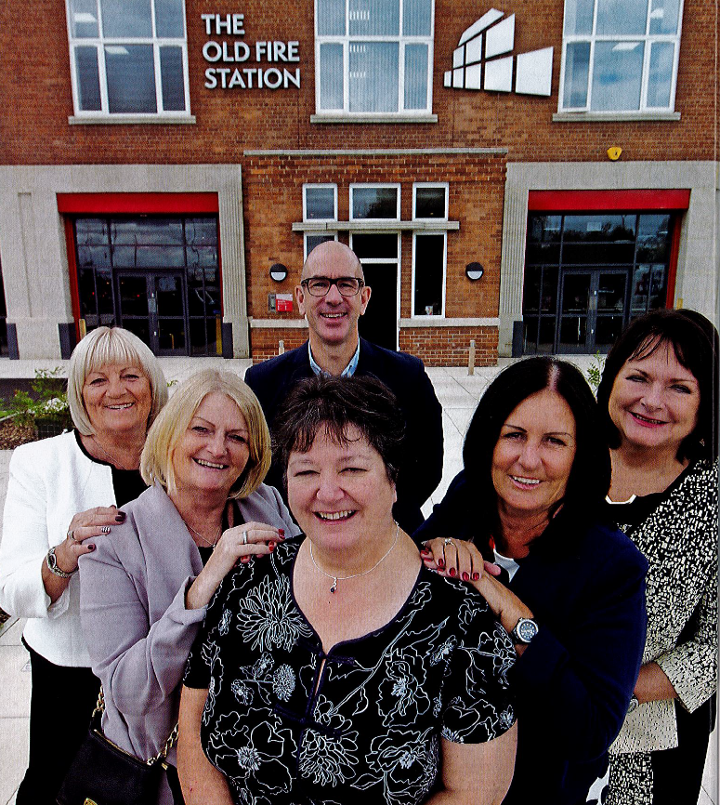
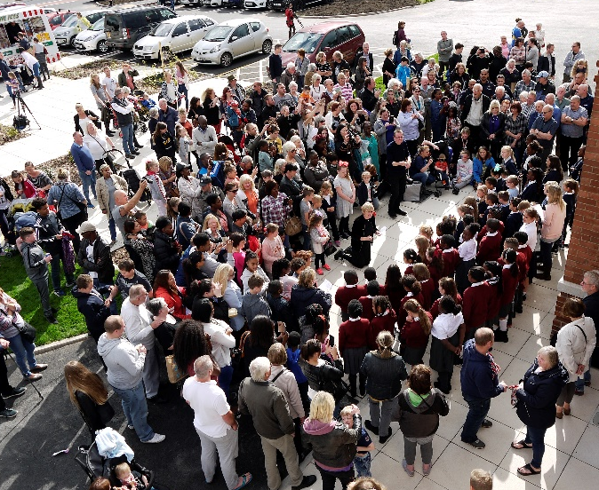
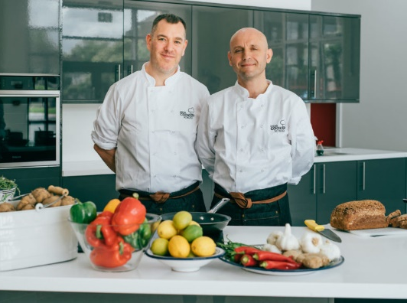
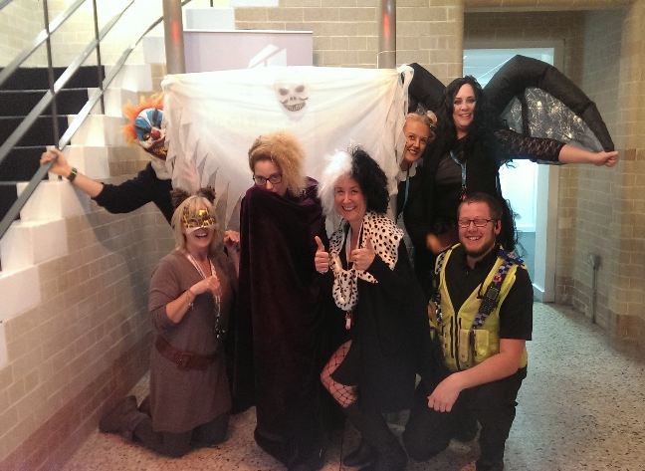
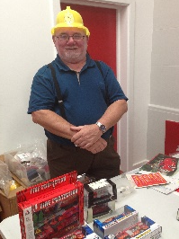
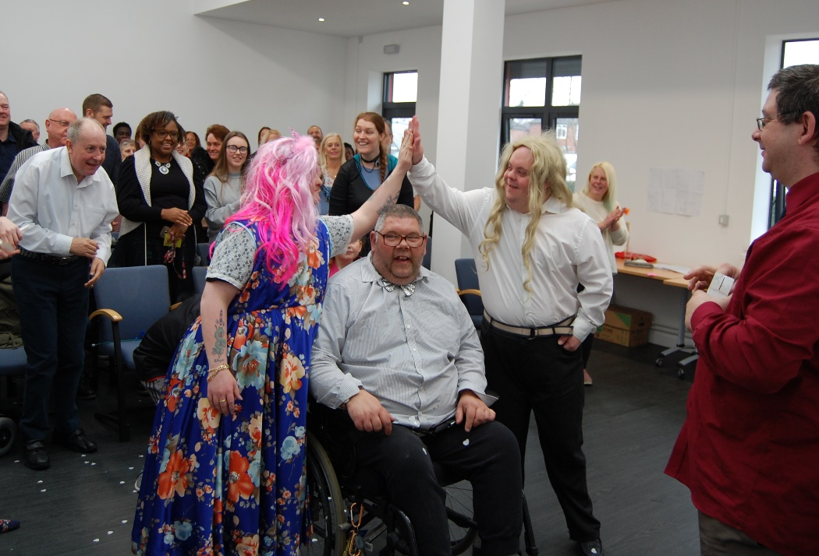
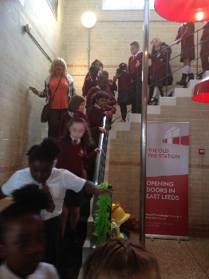
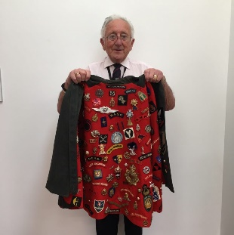
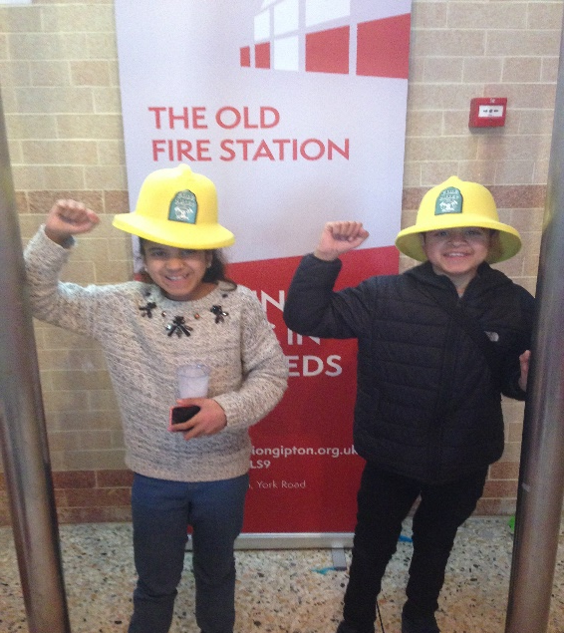
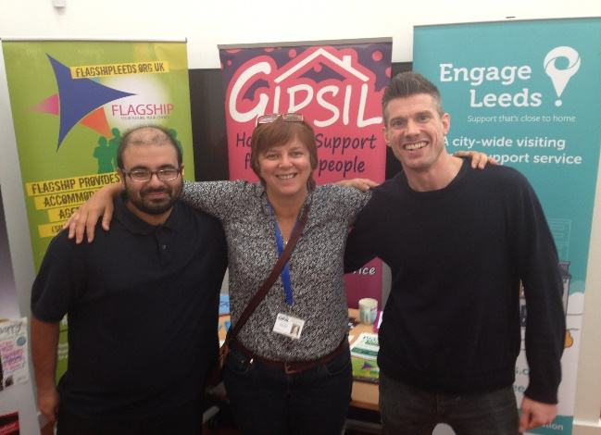
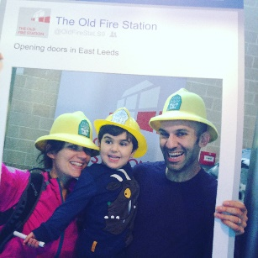
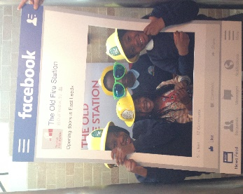
Activities, classes and events

Slide 15
Laura Moss – Wrigleys Solicitors - flexing your assets – the legal considerations
• Community group structures and governance – Leeds Community Homes
• Community asset transfers – Yorspace / Lowfield Green
• Community investment (shares and bond issues) – Energise Barnsley

Slide 16



Leveraging new sources of funding…
What’s the motivation to use your assets more flexibly?
Business rates – benefitting from reliefs e.g. charitable exemptions…
Cost sharing and efficiencies…
Responding to the needs of your community…
…others?

Slide 17
Quicker, more agile and nimbler solutions vs longer term and deeper solutions
Sub-letting and leasing e.g. Seagulls Leeds
Partnerships and joint ventures (constitutional and/or contractual) – what this means, what are the risks and opportunities and how you manage them, e.g. Nudge Millennium, Waste into Wellbeing Kendal
Informal arrangements, allowing co-working or other informal activities in your building on a short term basis, e.g. Memorandum of Understanding

Slide 18
Charity law and what your purposes permit
Terms of funding for using an asset in a particular way (donations, community investment and debt)
Property covenants
Planning rules
What flexibility do you have?
Reputational implications
Tax treatment
Resource constraints

Slide 19
Things to consider:
Assessing risk of activities?
How will the arrangement be funded?
Due diligence on partner organisations – strengths and weaknesses?
What does each party bring to the table?
How will the relationship be documented?
Need for separate legal structure?
How will problems and disputes be dealt with/resolved?
How to terminate the arrangement?

Slide 20


Maximising use of community assets in a Cost-of-Living Crisis – current challenges and new ideas
The SOAR Experience
Megan Ohri -Partnership manager

Slide 21
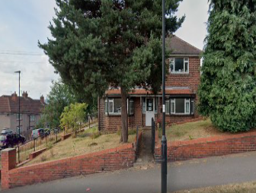
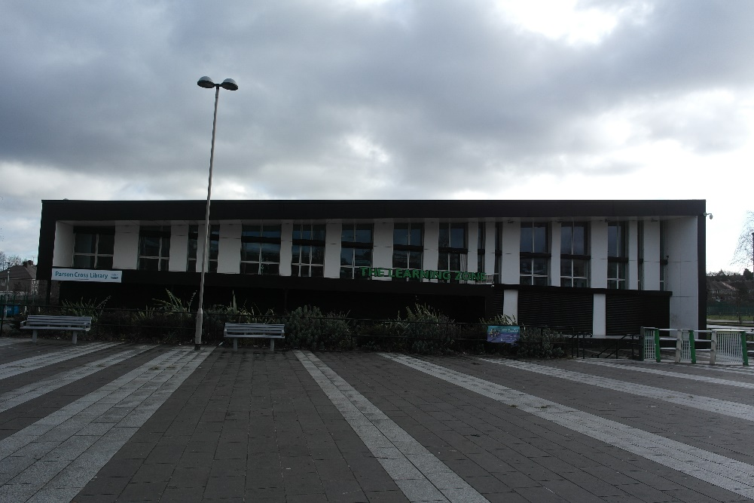
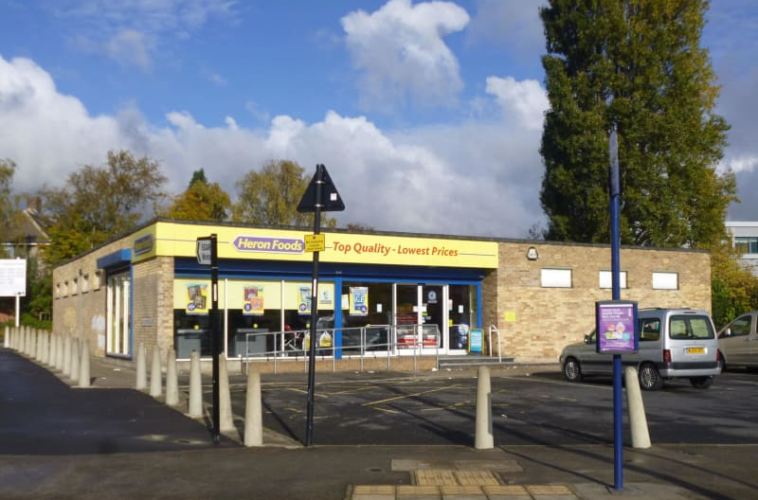
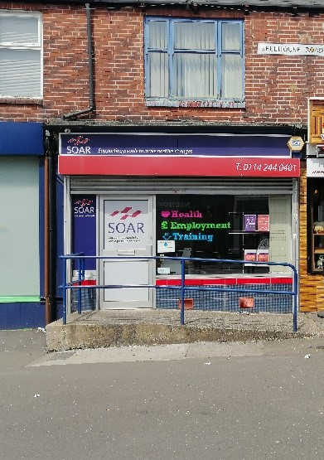
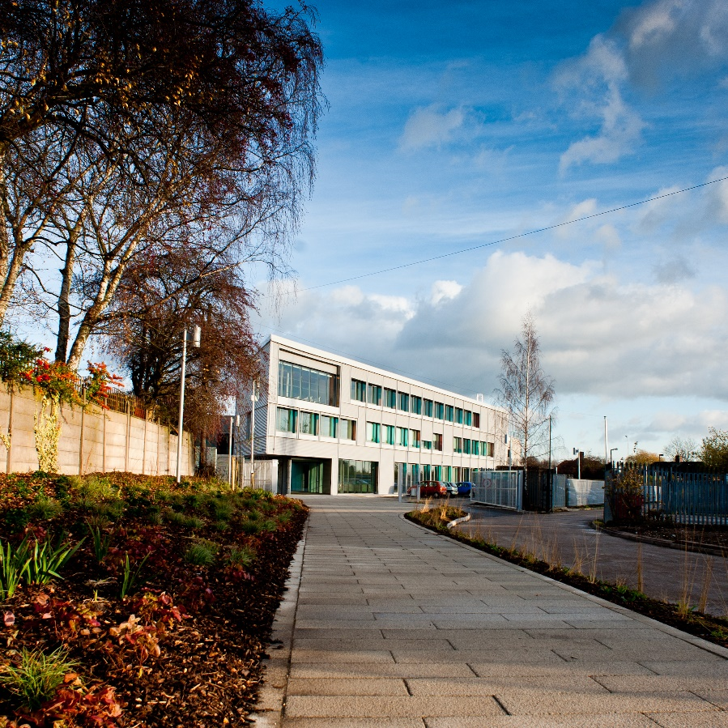
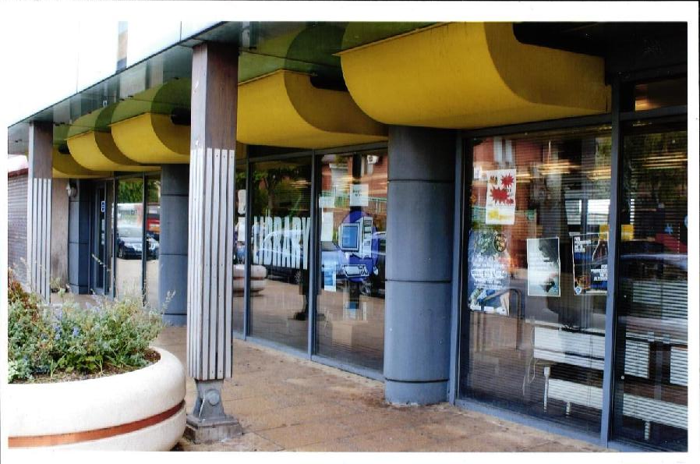
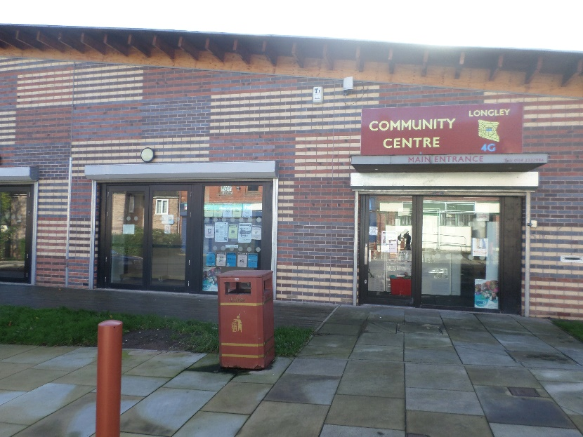

Slide 22

Commercial Properties
100% let plus a waiting list
Diversity of businesses from plumbers and
architects to VCSE and artists
A sense of community within the centre
Tapping into a desire ‘to be more ethical’- Non-profit, green credentials
Sessional lets are getting back to pre-pandemic levels at some centres
Currently promoting co-working spaces to capitalise on under-used spaces and link with COL. Warm spaces to work

Slide 23

Community Spaces: Challenges
Balancing community need Vs what’s affordable and possible
Volunteer led spaces – with aging committee members
Sessional income still recovering - budget squeezes knock on effect

Slide 24

Support for Warm Spaces
1. Coordination and joint promotion: including re: imagining existing groups
2. Staffing / volunteer recruitment support and training
6. Shared facilities and finance functions
5. Management committees…recruitment and support from the grassroots
3. Support to access funding - small grants and Joint working with SCC (LAC) for a joined up process
4. Longer term project around sustainability of centres

Slide 25

If you would like to discuss further or receive more information about SOAR, please contact: Megan Ohri
Megan.ohri@soarcommunity.org.uk
0114 213 4066
SOAR Works Enterprise Centre, 14 Knutton Road, Sheffield, S5 9NU

Slide 26
“breakout rooms for 5 mins to reflect on each speaker and to think of questions they would like answered?”

Slide 27

Open discussions on your experiences and aims

Slide 28
“What are your key takeaways from this session?”

Slide 29
Thank you to our speakers and you for you contributions! The speakers are all at Convention so if you are there say hello

